Slide 1
Movies Classification based on Plot summaries
Ankit Kumar Honey
Python for Data Science, CSCI E-29
Harvard University

Slide 2



CSCI E-29 2018 Staff
Nenad Svrzikapa
Instructor
Lena Hajjar
Teaching Fellow
Philip Lodine
Teaching Fellow
Kaleigh Douglas
Teaching Fellow
Alan Xie
Teaching Fellow
Joe Palin
Teaching Fellow

Slide 3
Abstract
Max = 10
Applications like Netflix, HBO Go and Amazon Prime provide lists of movies based on genres, so it is easier for viewers to select those movies that interests them based on genres.
Movie classification based on genre is a subjective and difficult problem because It involves complex and manual process where viewers classify the movies to a particular genre based on their interpretation. This problem varies based on viewer’s interest, so movie classification is not always accurate and time consuming.
Generalization of movie classification process with the help of machine learning techniques will make this process fast, consistent and more accurate and will also save us from human errors and efforts.
This project involves data gathering , data cleaning and feature engineering.
This project explores 3 supervised Machine Learning algorithms to predict movie genres based on only plot summaries.

Slide 4
Required Libraries and files
Anaconda
Pandas
NumPy
Sklearn
Fileinput
DATASET LOCATION
ftp://ftp.fu-berlin.de/pub/misc/movies/database/frozendata (Originally)
https://github.com/honeyankit/graduateprojectE29/data
URL FOR Downloading Notebook
https://github.com/honeyankit/graduateprojectE29

Slide 5
Machine Learning Process
Data Gathering
Data Preprocess
Feature Extraction
Feature Vector
Classifier
Evaluation

Slide 6
Vector Representation and Classification - Approach 1
Movie Plots
TF-IDF Vectorization
ML Classifier
Evaluation

Slide 7
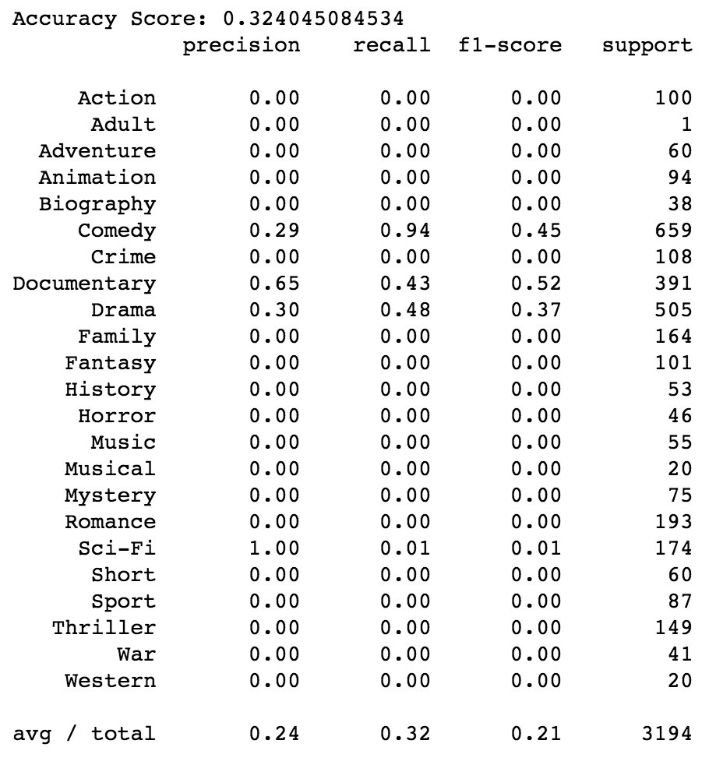
Naive Bayes - MultiNominalNB
Movie Plots
TF-IDF Vectorization
MultiNominalNB Classifier
Evaluation

Slide 8
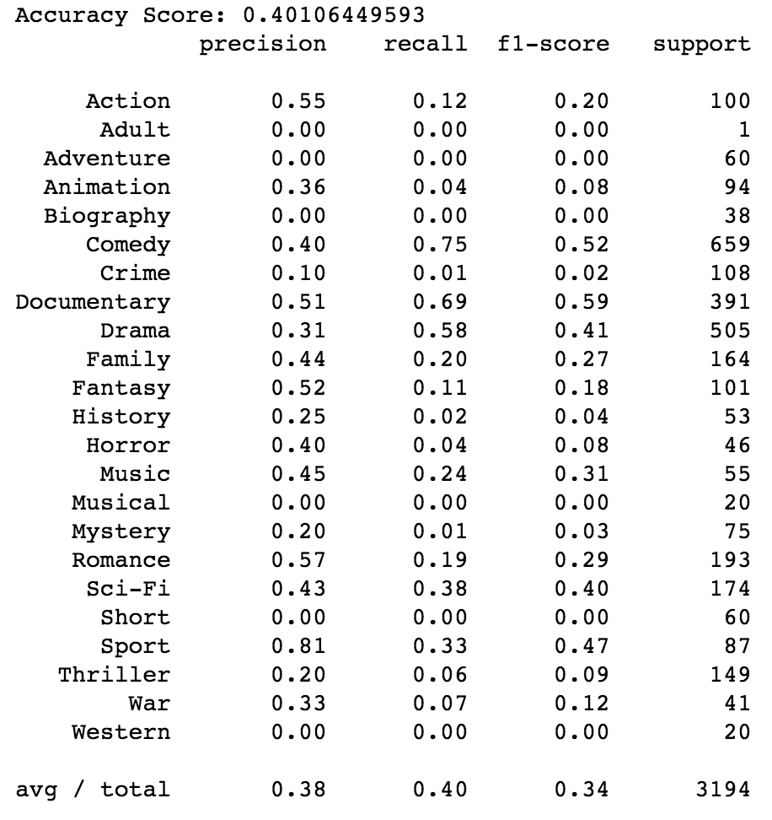
Linear- LogisticRegression
Movie Plots
TF-IDF Vectorization
LogisticRegression Classifier
Evaluation

Slide 9
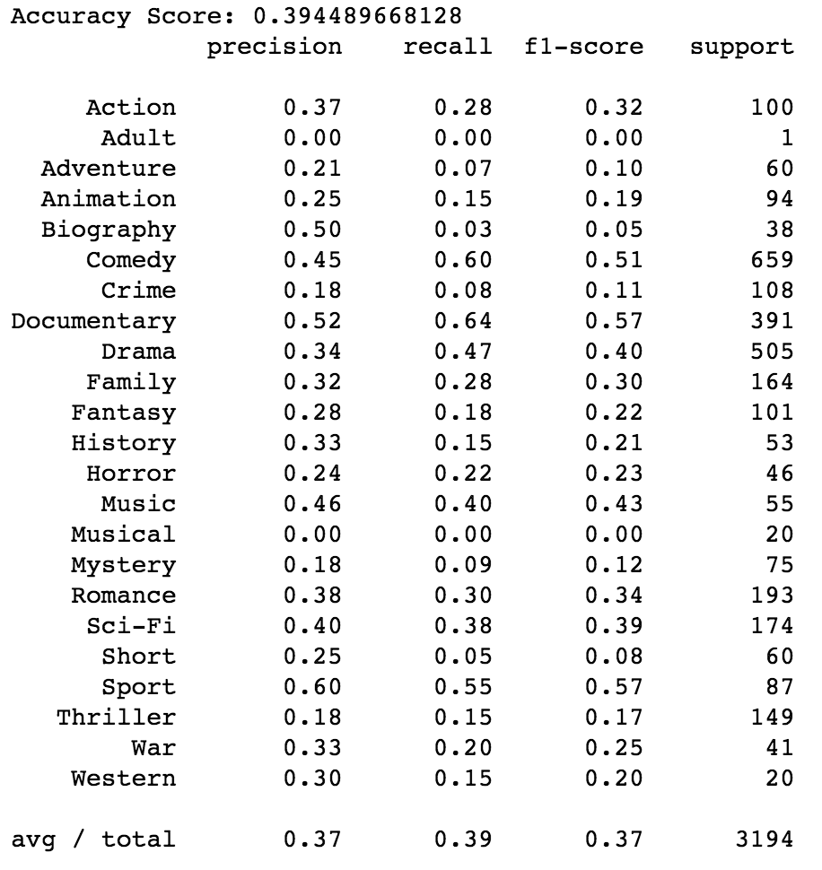
SVM – LinearSVC
Movie Plots
TF-IDF Vectorization
LinearSVC Classifier
Evaluation

Slide 10
Vector Representation and Classification - Approach 2
Movie Plots
ML Classifier
GridSearchCV
ML Classifier With Best Parameters
Evaluation
TF-IDF Vectorization

Slide 11
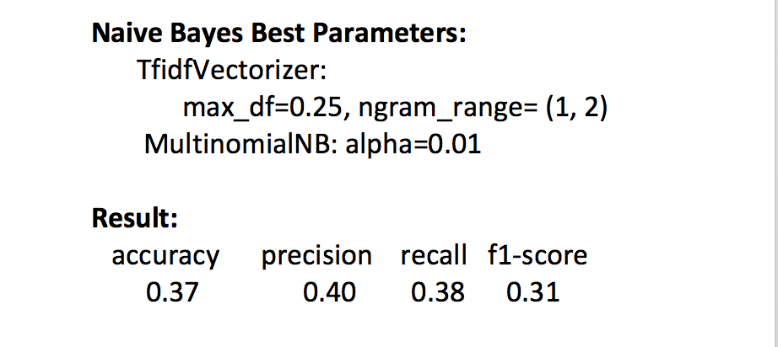
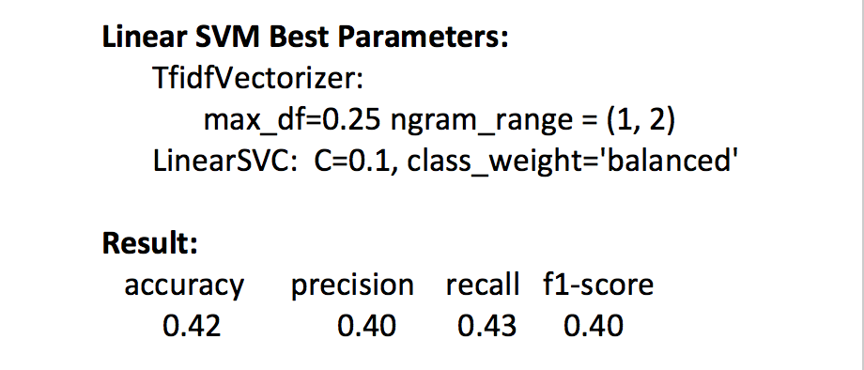
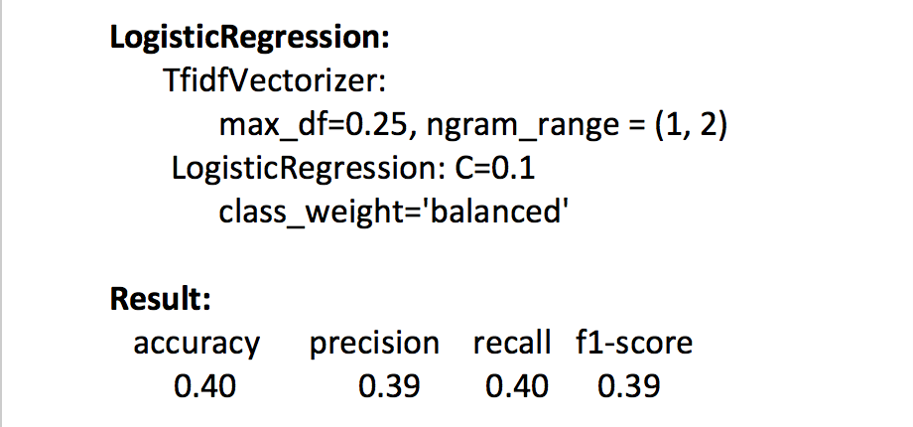
Parameter Tuning Through GridSearchCV - Result
Better Model

Slide 12
Conclusion
This project explores 3 ML methods (Naive Bayes, LogisticRegression, LinearSVC) with two different approaches to predict the genre of the movie based on plot summary. We are trying to solve Multi-Classification problem which is very challenging in nature.
There are many directions in which we can move from here to make our model better. For example we research on using libraries like word2vec, doc2vec to improve vectors of words in a document. These libraries not only count words and but also store the concept of the word which is missing in TF-IDF vectorization.

Slide 13
REFERENCES
Introduction to Machine Learning with Python
Python Data Science Handbook
https://arxiv.org/abs/1801.04813
https://machinelearningmastery.com
https://radimrehurek.com/gensim/tutorial.html
https://pdfs.semanticscholar.org/e075/8e7b92be47255ae655bfef8e8c15e34ec569.pdf

Slide 14
Acknowledgments
Thank you all Teaching Staff of E29 Course (Spring 2018)

